Slide 1
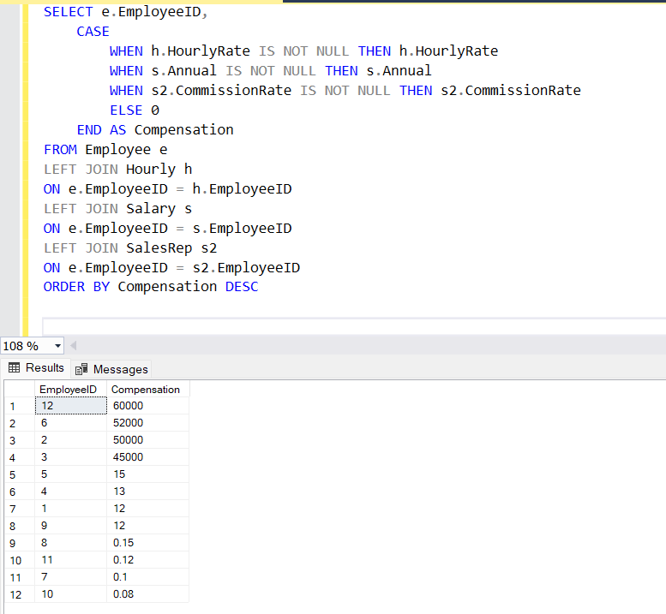
List of all employees and their current compensation due, grouped by employee type, and resorted by highest salary

Slide 2
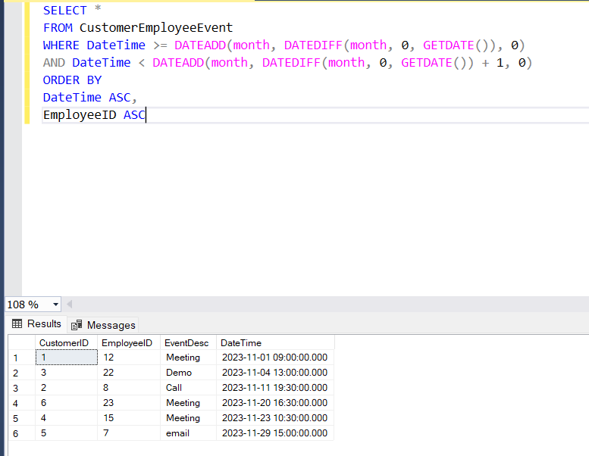
List all customer/employee events during a one month period. Sort by date, resort by employee

Slide 3
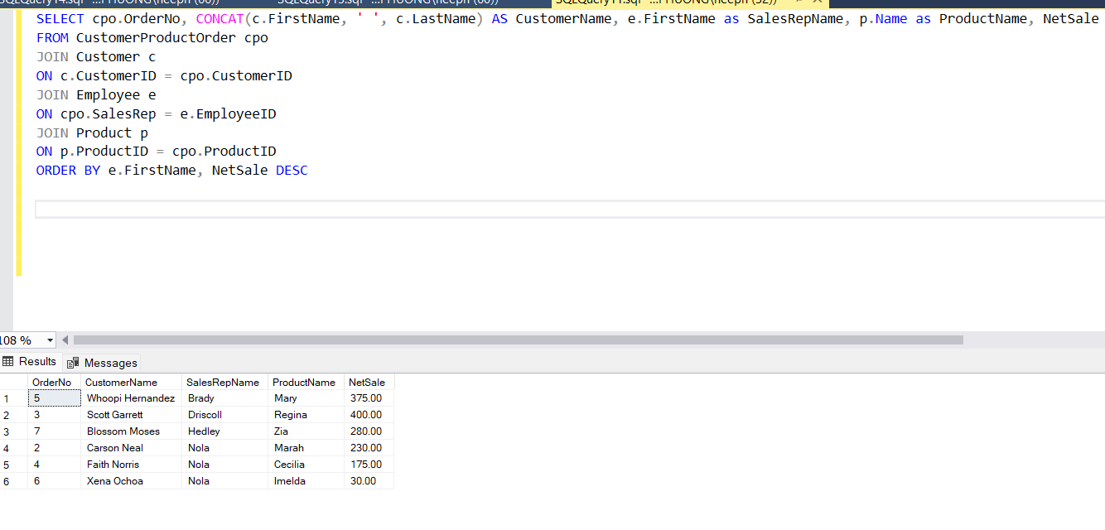
List of all customer orders, the customer’s full name (concat), sales rep credited with the order, and the individual products within each order, grouped by sales rep and sorted by highest sales (number of units or amount sales)

Slide 4
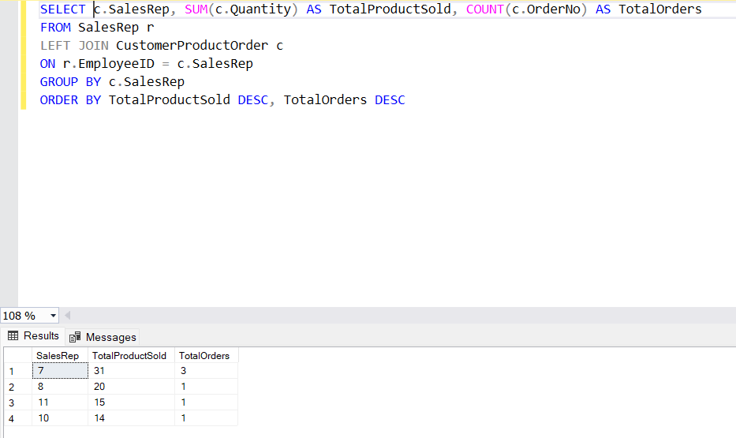
List of all Sales Reps with their total number of orders sold, total number of units sold – and highest, lowest, average dollar value generated, sorted by Sales Rep, resorted as highest to lowest orders, units

Slide 5
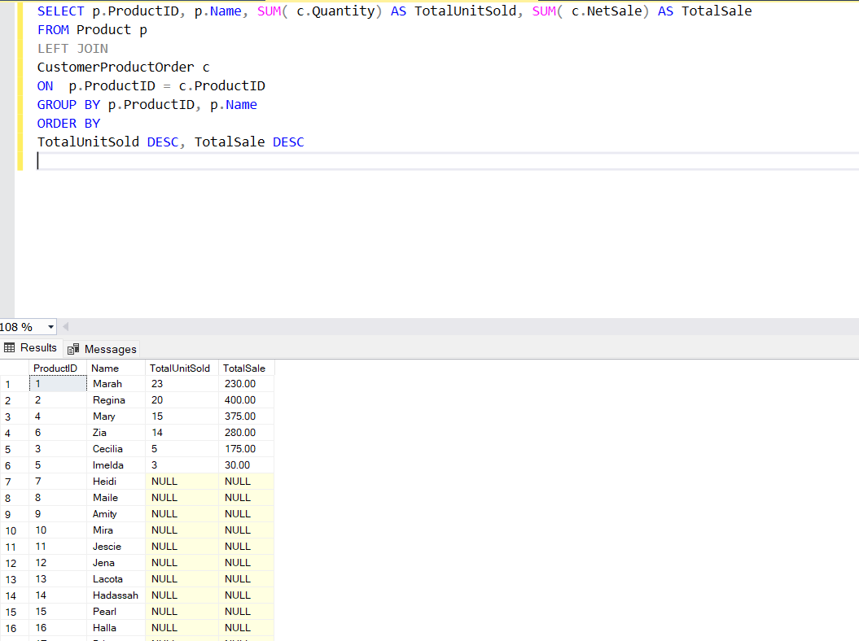
Result set reporting most and least popular product sold, with their total units and dollar value generated

Slide 6
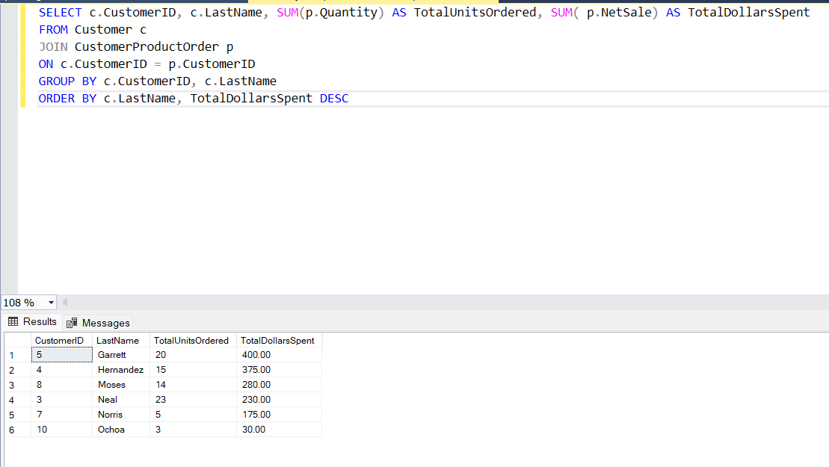
Result set listing all customers by last name, all the products they have ordered and total dollars spent; sorted by customer and highest dollar value

Slide 7
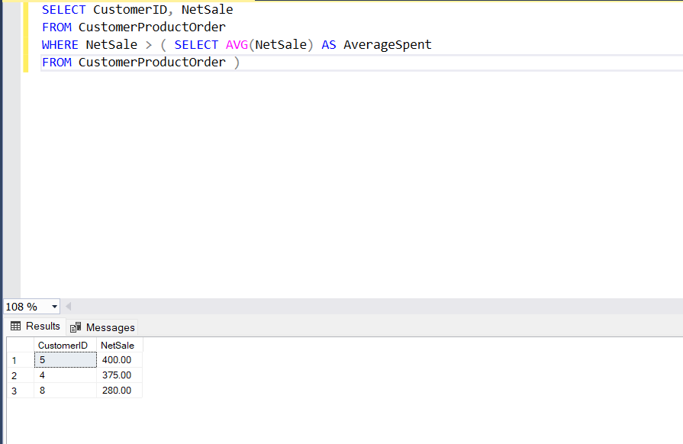
List all customers that have spent more than the average.

Slide 8
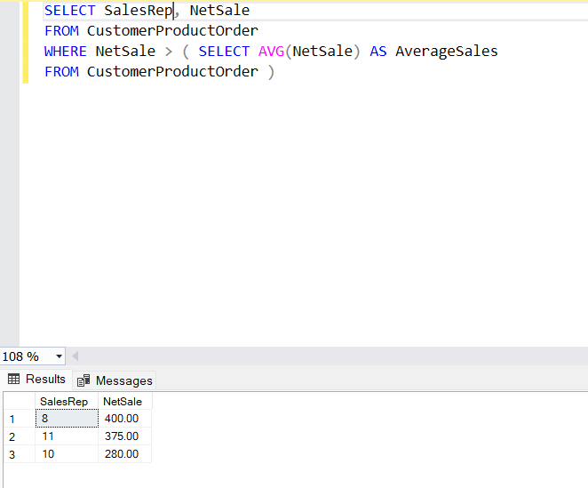
List Sales reps who have sold more than average.

Slide 9
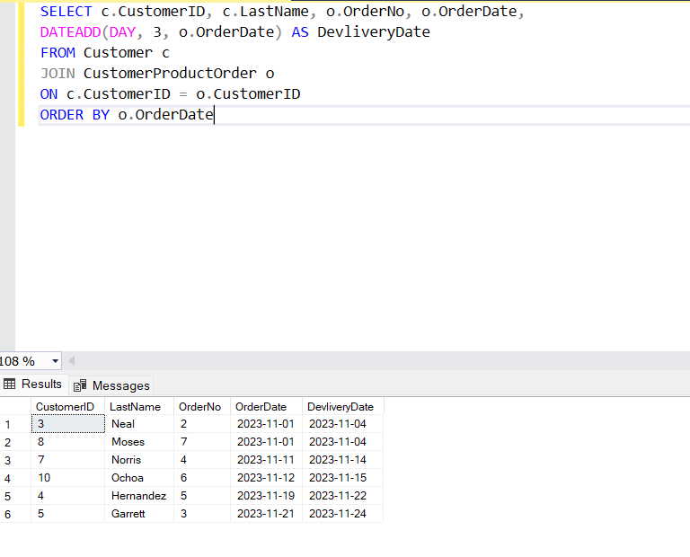
Use DateAdd (3 days) to list customer orders by name, order number, date of order and date of delivery

